Slide 1
Present status of the S-104 Product Specification
Greg Seroka, NOAA, USA and Zarina Jayaswal (TWCWG Water Level Project Team Lead), Australian Hydrographic Office
COMPONENTS OF THE S-104 PRODUCT SPECIFICATION
Main Document (ver. 0.0.6, under TWCWG review by Nov 2018)
S-100 WG checked for S-100 compliance (Nov 2017), comments from S-129 (Sep 2018)
Data Classification and Encoding Guide
Establish Feature(s) and Attributes (F&A) (Draft Annex A, feedback from this meeting)
Enter F&A into the IHO GI Registry
3. Feature Catalogue (XML)
4. Portrayal Catalogue (portrayal discussion at this meeting)
Establish Symbol
Convert Symbol into SVG Files
Portrayal rules – plain text
Portrayal Rules (XSL)
Enter symbol into Portrayal Register
Exchange Format
S-104 EXCHANGE FILE CREATION
S-100 Dataset (HDF5) (to be started in coming months)
Catalogue File (XML)

Slide 2
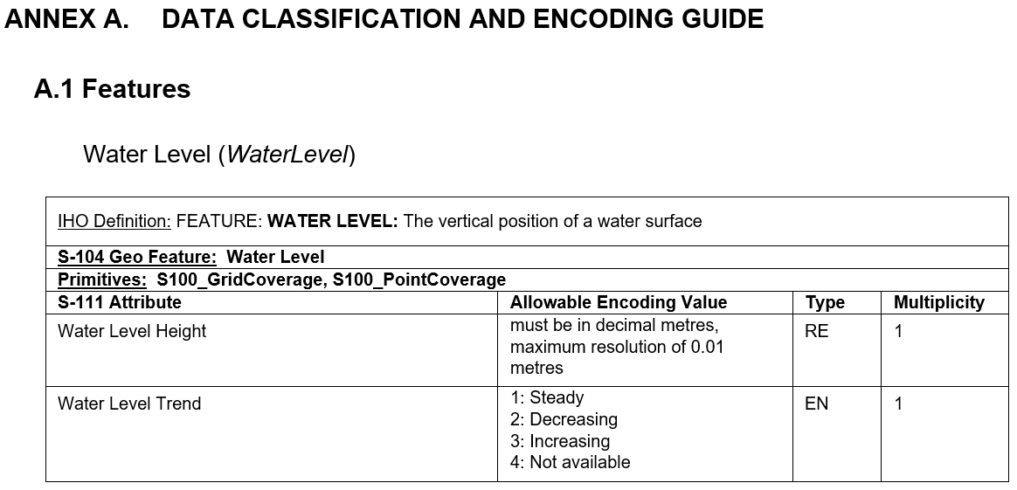
Feedback on S-104 Features & Attributes - 1
Notes:
-Previously, Allowable Encoding Value for Water Level Height was “must be in decimal metres, minimum resolution of at least 0.01 metres”. Zarina Jayaswal, TWCWG Water Levels (S-104) Project Lead suggested the change to “maximum”.
-Justification: This change is consistent with Section 12.4 feature type: WaterLevel, there was a bit of discussion within the group regarding the number of significant figures to be displayed and how precision is different to accuracy. Especially with charted soundings being published to the nearest decimetre. Pilots and under keel clearance systems may publish to the nearest centimetre but accumulative error to determine the sounding depths (including water level measurement) is at best +/- 10 cm.

Slide 3
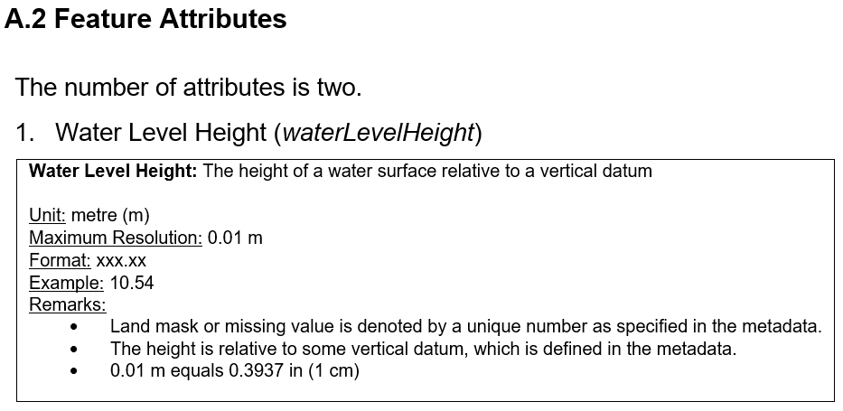
Feedback on S-104 Features & Attributes - 2
Notes:
Same change as previous slide- “Minimum Resolution” was changed to “Maximum Resolution”, suggested by Zarina.

Slide 4
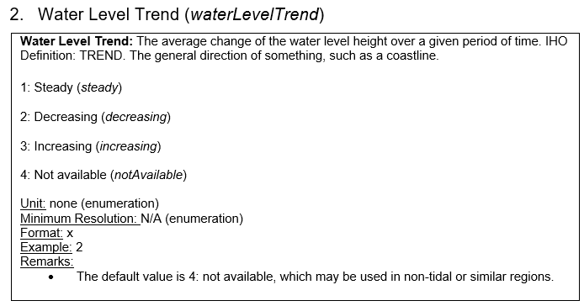
Feedback on S-104 Features & Attributes - 3
Notes:
-Definitions for “steady”, “decreasing”, “increasing”, “not available” were not included in the encoding guide, can be elsewhere in a table in the PS (not metadata?)
-If the gridded hydroid is not a water level, the Encoding Guide will need to be re-written to accommodate it. The hydroid is a field of differences between two datums.
-Encoding guide will likely need to accommodate 1) hydroid and 2) waterLevelHeightUncertainty

Slide 5
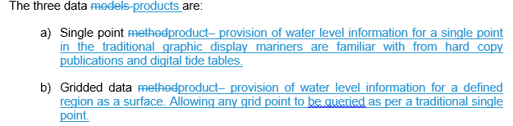

Other updates
Tidal zones of influence changed to “gridded hydroid”
After discussions with S-129 chair, changing product type 3- tidal zones of influence to a gridded hydroid (Chart datum above Ellipsoid).
Reasoning:
Tidal zones of influence was suggested before S-129 working group was created
S-129 is not directly dependent on S-104 products
A product more looking into the future rather than what is currently used or historical.
Reduces the complexity of S-104.
Notes:
-If the gridded hydroid is not a water level, the Encoding Guide will need to be re-written to accommodate it. The hydroid is a field of differences between two datums.
-How the hydroid information is displayed has not been decided. It may be that the layer is not displayed but a display of real-time water depth below ship reference point using the layer information and the ship’s Ellipsoidal Height from GNSS unit.

Slide 6
Other updates/questions
Gridded hydroid
Could be used in places with no tide gauges; marine pilots currently use this in some ports with UKCM systems
Hydroid model maps ellipsoid to chart datum separation; new data refines model, decreases error for that region
Rename “hydroid”?
Ellipsoidally referenced tidal zones (ERZT) used in places
Possible names for feature/attribute:
Feature: Datum Difference (DatumDifference) or Hydroid (Hydroid)
Feature attribute: Difference Value (differenceValue) [meters] or ?
Notes:
Tidal zones of influence is an old method for tidal reduction for charts, newer method that has been progressively adopted by countries is the use of a hydroid model. The hydroid model maps/charts the ellipsoid to chart datum separation. This model would get updated a bit like charts, where newer data comes in to refine the model, decrease the error for that region.
Yes, this could be used in places where you don’t have tide gauges, to get estimate of how much water under the keel you have.
Marine pilots currently use this in some ports with Depth underkeel clearance systems.
-as for 'datum difference', in the US we have VDatum, which transforms between 29 or so vertical datums. To pick only one, the 'hydroid', seems shortsighted.

Slide 7


Other updates
Example scenario diagram
ellipsoid
(which?)
GNSS
hydroid
ship (water surface)
e.g. waterLevelHeight
chart datum (e.g. NOAA: MLLW)
nautical chart value (S-102 bathymetry on S-101 ENCs)
SONAR (water depth)
sea bottom
Notes:
(a) the ellipsoid, datum, and sea bottom are all spatially varying, and (b) since there are many ellipsoids, the specific one must be specified.
Also, be aware that the ellipsoid is measured from an antenna mounted high up on the ship, and the sonar measures depth from a level below the water level. Thus there is an extra term(s) to compute this elevation difference.
-Gridded hydroid
-Source: hydrodynamic models, GPS data points, spatial interpolation
-Use:
-hydrographic surveying (Kurt): derive water depth (relative to chart datum) using formula: water depth = [(distance from ellipsoid to ship) + (distance from ship to sea bottom- from Sonar)] - (distance from ellipsoid to chart datum "hydroid" )
-UKC (Greg; Kurt thinks one needs gridded instantaneous sea level relative to chart datum values): derive water depth using formula: water depth = [(distance from ellipsoid to chart datum, "hydroid") + (distance from chart datum to sea bottom- from ENC)] - (distance from ellipsoid to water surface- from GNSS?)
-waterLevelHeight
-Source: model, observations, etc.
-Use: derive water depth using formula: water depth = (distance from water surface to chart datum, "waterLevelHeight") + (distance from chart datum to sea bottom- from ENC S-101 and S-102 gridded bathymetry on ENC itself)

Slide 8
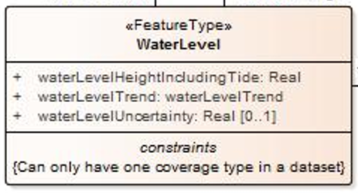
Other updates/questions
How to include uncertainty?
S-111: horiz/vert position, time uncertainty in metadata; speed, direction uncertainty optional attributes at each time
S-104: waterLevelHeightUncertainty as optional attribute? horiz/vert position, time, datum uncertainty in metadata
e.g. for data type 2: regularly gridded data, don’t produce field of uncertainty values; rather, supply a number for entire grid as in S-111
Notes:
Uncertainty: waterLevelHeight uncertainty, time uncertainty, horizontal position uncertainty, vertical uncertainty, datum uncertainty (CO-OPS provides uncertainty of datum itself), high and low water level uncertainty, time of high and low water level uncertainty
-uncertainty is spatially and temporally-dependent, could double or more size of files, uncertainty is uncertain itself
-Are weather producers going to give uncertainties as a field for pressure, temperature, etc? Are member states capable of providing fields of uncertainty values?

Slide 9
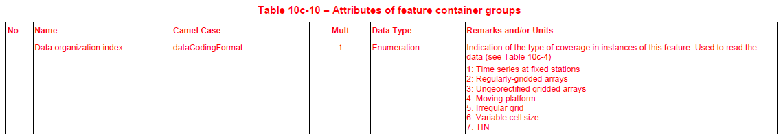
Other updates
Three data/file types:
Single point data (S-100 dataCodingFormat 1)
Regularly gridded data (S-100 dataCodingFormat 2)
Ungeorectified gridded data (S-100 dataCodingFormat 3)

Slide 10
Other updates/questions
Table 7.1 – Types of water level data, based on the source of data
Type | Name | Data types | Description
1 | Historical | Single point | Observation made hours, days, etc. in the past
2 | Real-time | Single point or ungeorectified gridded | Observation no more than a few minutes old
3 | Astronomical | Single point, regularly gridded or ungeorectified gridded | Value computed using harmonic constants only
4 | Analysis or hybrid method | Single point, regularly gridded or ungeorectified gridded | Calculation by statistical or other indirect methods, or a combination of methods
5 | Hindcast | Regularly gridded or ungeorectified gridded | Gridded data from a two- or –three dimensional dynamic simulation of past conditions using only observed data for boundary forcing, via statistical method or combination
6 | Forecast | Regularly gridded or ungeorectified gridded | Gridded data from a two- or three-dimensional dynamic simulation of future conditions using predicted data for boundary forcing, via statistical method or combination
7 | Hydroid | Regularly gridded or ungeorectified gridded | Gridded data representing separation surface between ellipsoid and chart datum

Slide 11
Other updates/questions
Not portraying yet
Only time series (e.g. water level vs. time), no gridded water level surface portrayal as of S-104 v0.0.6
Is there a user need to display gridded water levels?
e.g. route planning: tidal windows of opportunity using ship drafts (is this S-104?)
Notes:
-Portrayal of gridded water level – think there was discussion of making the each of the gridded nodes accessible like a single point. Using the same single point symbology. Gridded data allows the software manufactures to integrate tidal windows of opportunity using ship drafts into route planning.

Slide 12
Other updates/questions
What does the user want to see for S-104?
If an ultimate goal is to update chart (e.g. S-101) water depths (using bathymetric data (e.g. S-102) and water level data (S-104)), how to best do that? (in S-104 or not?)
What is interoperability with S-129 under keel clearance? What is the overlap, if any? Are there redundancies to avoid?
Notes:
-What is integration of S-104 with the S-129 UKC group?
Concerns/considerations for updating water depths on ENC: uncertainty as they are predictions; atmospheric pressure, wind and not just tidal information in water level predictions from numerical forecast models
-updates to a chart based on predicted gridded water level information should be indicated as such, and not indicated as an “official” or “low uncertainty” update to the chart (need to consider potential result of confusing the mariner- italics option different enough from regular font water depths on ENC?)
-in S-104 v 0.0.6 section 9.3 Display of single point location from Regularly Gridded data: “There is no adjustment of bathymetry data and no gridded water level surface will be portrayed Because both of these options are outside the scope of this specification.”

Slide 13
Creation of S-104 HDF5 files
Three data/file types:
Single point data
Regularly gridded data
Ungeorectified gridded data
Some Member States (MS) in TWCWG are creating test files
Stationary and regularly gridded
Canada: tidal time series predictions
U.S. NOAA: soon to produce regularly gridded water level predictions from Operational Forecast Systems, like for S-111 HDF5 files
Other MS
Notes:
Moving Platform? (e.g. drifters- accurate enough?) – moving platform (e.g. drifting) tide gauges are not really a thing (measuring vertical water movement)

Slide 14
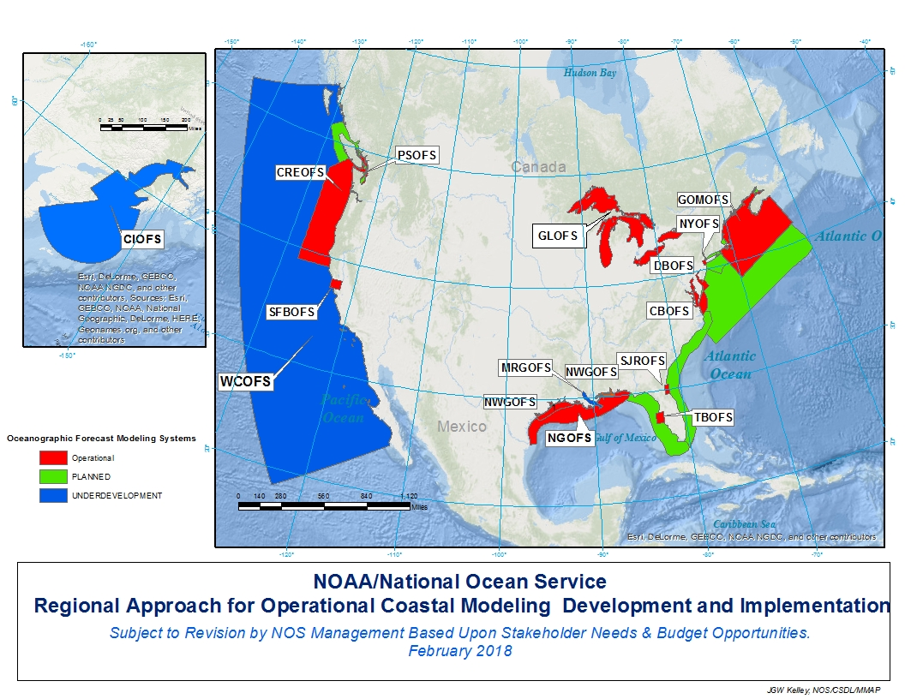
US/NOAA Operational Forecast System Map

Slide 15
Supplementary Slides

Slide 16
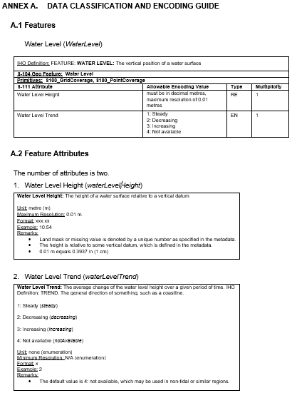

Slide 17
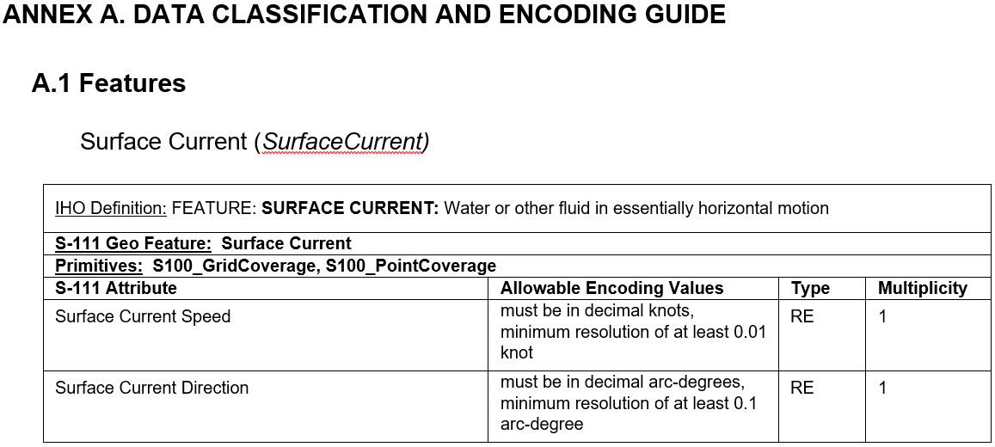
S-111 Features and Attributes - 1

Slide 18
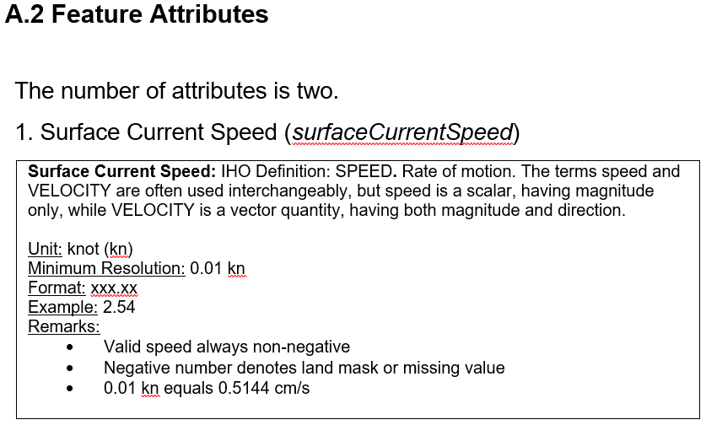
S-111 Features and Attributes - 2

Slide 19
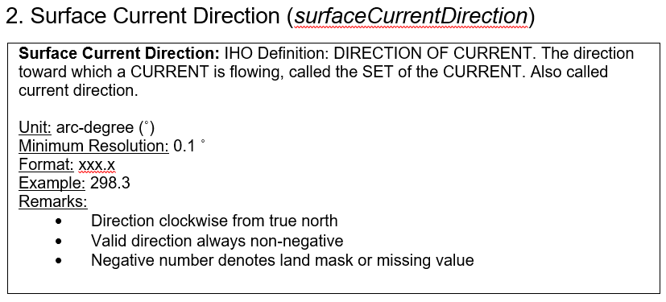
S-111 Features and Attributes - 3

Slide 20
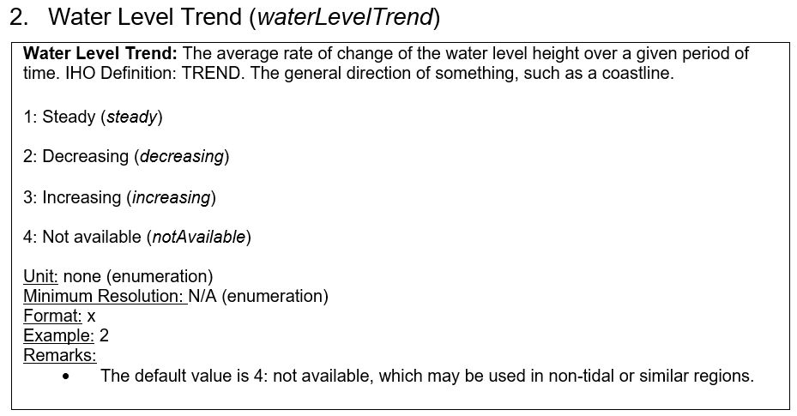
How/where to define waterLevelTrend?
Definitions not in encoding guide, can be elsewhere in a table in the PS (not metadata?). For example:
steady: absolute value of average change of water level height over a one hour period is less than 0.20 m e.g. 0.05 m/1 hour is steady
decreasing: average change of water level height over a one hour period is less than -0.20 m e.g. -0.34 m/1 hour is decreasing
increasing: average change of water level height over a one hour period is greater than 0.20 m e.g. 0.57 m/1 hour is increasing
Notes:
Time period (1 hour in example) and water level height threshold value (0.20 m in example) will be determined by data provider/MS/HO (but this is up for negotiation)

Slide 21
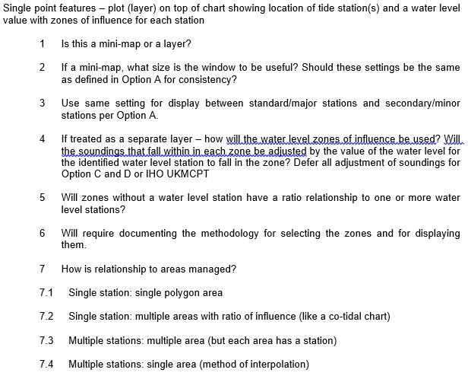
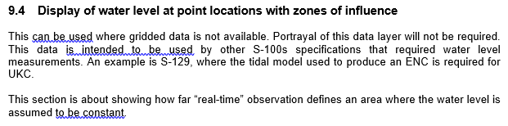
Other updates
Display of water level at point locations with zones of influence (now replaced with “gridded hydroid”)
Notes:
Concerns/considerations for updating water depths on ENC: uncertainty as they are predictions; atmospheric pressure, wind and not just tidal information in water level predictions from numerical forecast models
-updates to a chart based on predicted gridded water level information should be indicated as such, and not indicated as an “official” or “low uncertainty” update to the chart (need to consider potential result of confusing the mariner)

Slide 22
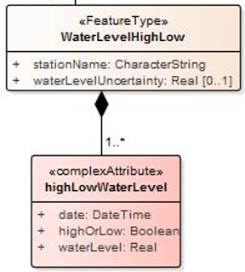
Other outstanding questions for Encoding Guide
Should we include 2nd feature “WaterLevelHighLow” for data type 1: fixed station data?
High and low tide times and values

Slide 23
Update
S-112 Dynamic Water Level Data Transfer will be discontinued; functionality will be in S-104 and/or generic S-100 Data Transfer standard
Tides, Water Level and Currents (TWCWG) to HSSC9: “The HSSC is invited to consider development of a generic S-100 Data Transfer standard rather than continue development of S-112”
HSSC9/38 HSSC noted that development of S-112 is no longer required as the functionality will be in S-104 – Water Levels - and agreed to reassign the S-112 identifier to another product specification as appropriate

Slide 24
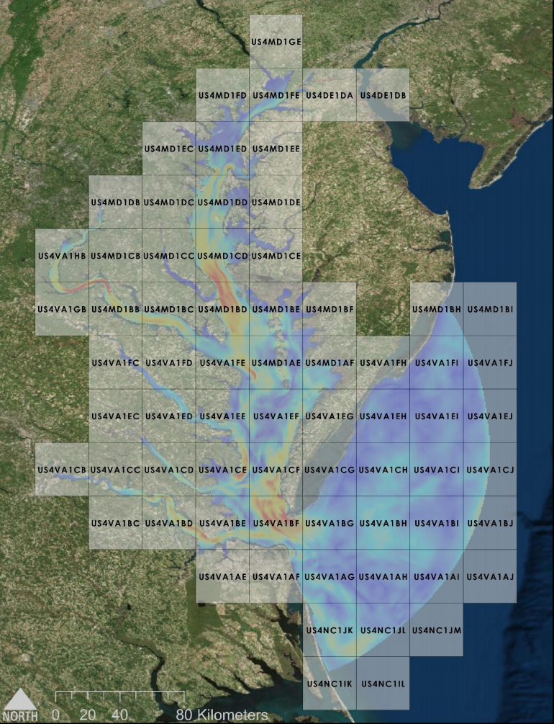
NOAA’s semi-operational production of S-111 HDF5 files
Predicted currents from the Chesapeake Bay
Operational Forecast System
Interpolated to a regular grid (500 by 500 m), at 4.5m depth below surface
Supply currents in separate files, at
high-resolution (band 4: 1 to 40k/80k) digital chart scale
69 Datasets, overall grid file size of ~12 MB
4 times daily cycle (0, 6, 12, 18 UTC), Forecasts are hourly out to 48 hours
Chesapeake Bay, with charts

